Slide 1
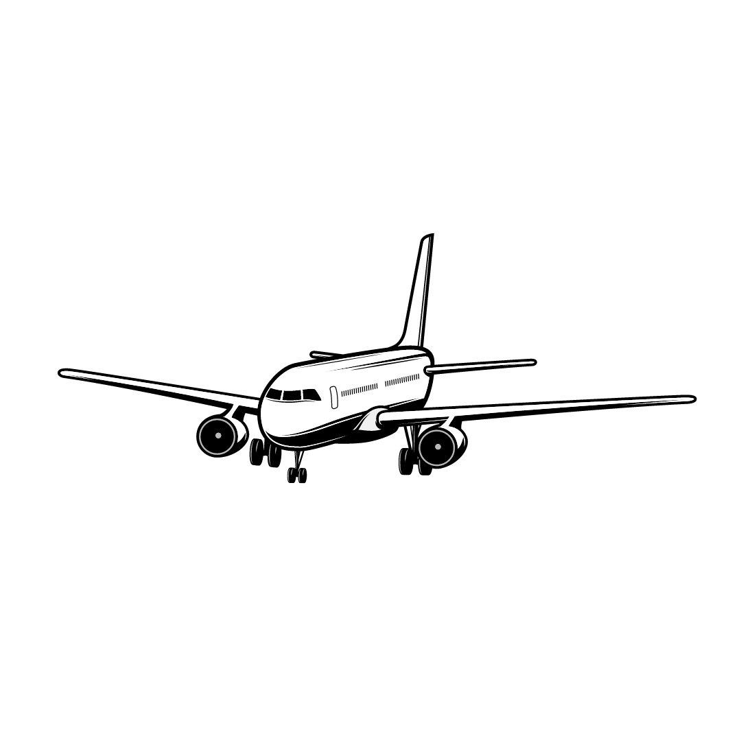
SafeFlightLB

Slide 2
Python Modules Required for the application
TTkthemes: pip install ttkthemes
Requests: pip install requests
BeautifulSoup: pip install beautifulsoup4

Slide 3
What’s SafeFlightLB?
SafeFlightLB is an application working with Real Data that guides you through your flight journey from Lebanon.
It can show you all the needed information about your flight using your flight number.
You can take a look at the actual COVID19 statistics in numbers of the Country you’re going to

Slide 4
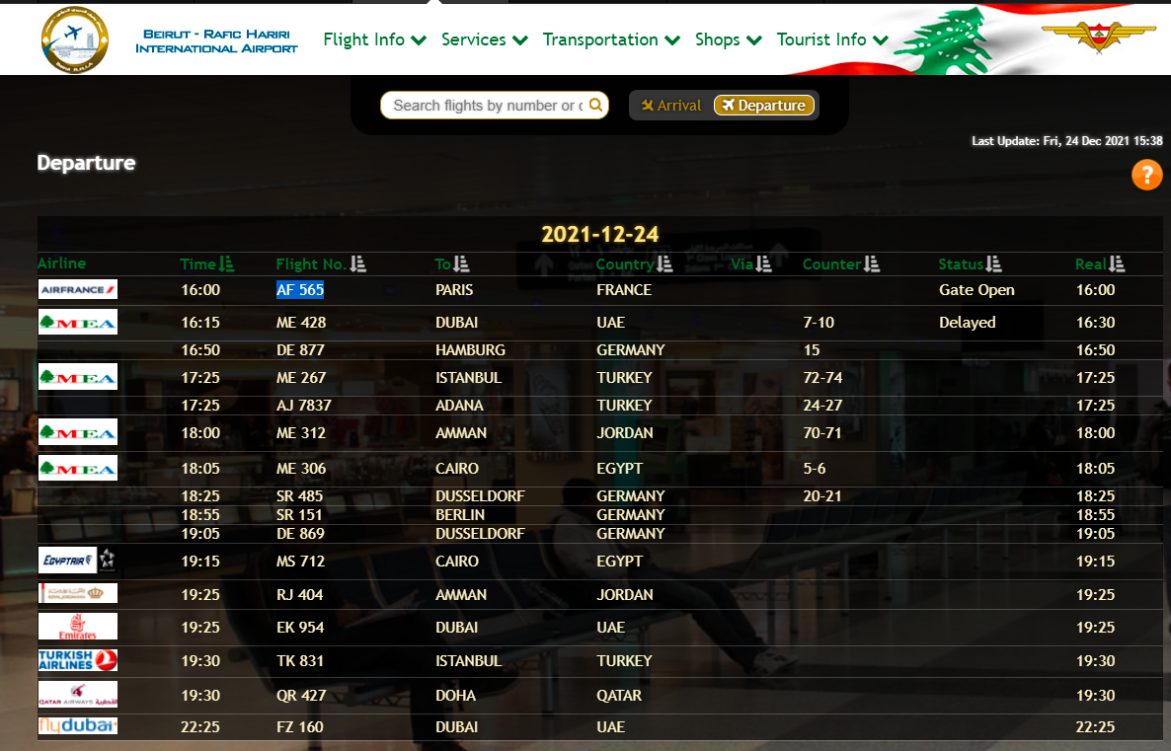
Application Overview
Step 1: Get a Real Flight Number, You can check :Flight Info - Beirut Rafic Hariri International Airport (beirutairport.gov.lb)
Make sure you get it from the flight departures page
Flight Number

Slide 5
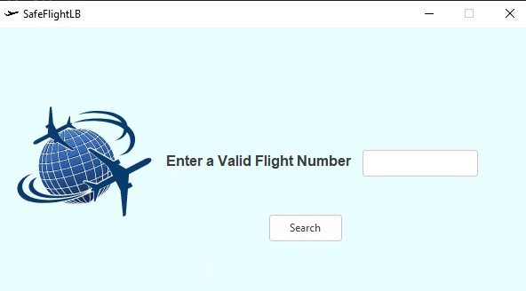
Enter the Flight Number here

Slide 6
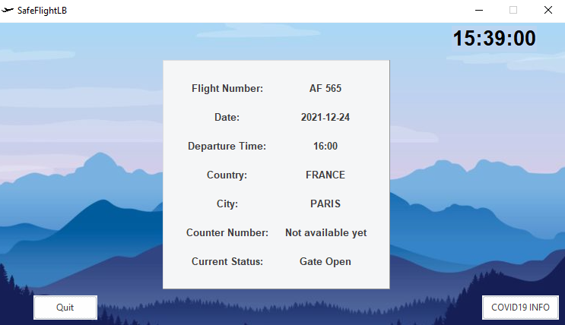
Local Time
Information about your flight trip.
COVID19 statistics of your destination
Quit

